Slide 1
CRICKET TEAM PREDICTION USING GRADIENT BOOSTING ALGORITHMS
BTP minor project
5th sem

Slide 2
Introduction
Fantasy sports leagues are a type of online game where players create virtual teams of real-world professional athletes. Players then earn points based on the individual performances of their chosen athletes in real-world games. The player with the most points at the end of the season wins the league.
Fantasy league team predictors are tools that use machine learning to predict the performance of fantasy league players. These tools can help players make better decisions about who to draft and start in their lineups.
Exponential rise of IPL in recent years has also resulted in popularity of fantasy games in India

Slide 3
Objectives
Developing a machine learning model for predicting a teams performance in a cricket match using historical data
To optimize team selection and strategy based on predictive insights
To provide valuable insights to coaches and team management
To win in fantasy league apps.
To create a model that would be able to predict the best combination of players.

Slide 4
Need of the project
Fantasy players face challenges in team selection and strategy, as there is a lack of predictive models for team selection keeping in view the statistics of the game.
Desire to improve team performance and increase chances of winning and the need for data driven decision making.
Growing importance of analytics in sports.
Emphasis on using technology for competitive advantage

Slide 5
Literature Survey
Journal/Author | Date of Publishing | Comments
Batsmen performance prediction using regression models Gayatri Bhatambarekar, Swarnim Rai | 2022 | 1.Dosen’t differentiate between different formats 2.has used random forest and SVM algorithm
Cricketer’s tournament-wise performance prediction and squad selection using machine learning and multiobjective optimization Devopriya Tirtho , Shafin Rahman, Md. Shahriar Mahbub | 2022 | 1.Has taken form, consistency and opposition factors into account. 2.Used linear regression, SVM ,random forest
Cricket Match Analytics Using the Big Data Approach MazharJaved Awan, Syed Arbaz Haider Gilani | 2021 | Used for analytics and score prediction not for team selection
DATA SCIENCE APPROACH TO PREDICT THE WINNING FANTASY CRICKET TEAM—DREAM 11 FANTASY SPORTS Sachin Kumar S , Prithvi H V [2] , C. Nandini [3] | 2020 | Used multi output regression algorithm which is not very accurate

Slide 6
Methodology
The methodology of the project is divided into 3 sub modules
Data collection and analysis: scraping ball by ball data from the internet. formatting the data into usable form.
Data transformation and feature engineering: transforming the data into appropriate Formats and adding additional categories to predict scores more easily.
Prediction of values and selection of team: Comparing various Classification and regression algorithms and selecting the best one for prediction.Choosing the best players on the basis of predicted values using Flask and vanilla HTML and CSS for building application for deployment.

Slide 7
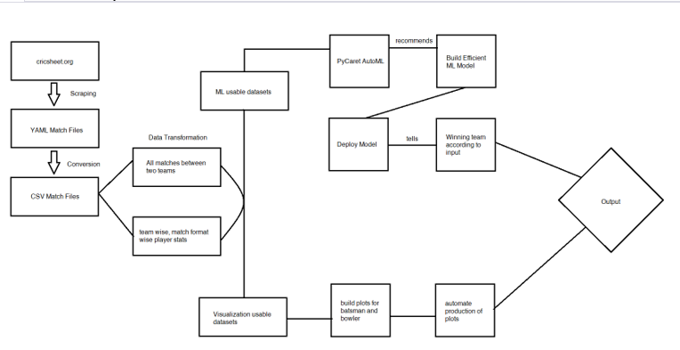
Flow of process

Slide 8
Data collection & Preprocessing
For data scraping, we identified reliable data source at cricsheet.org where we got dataset of 1200 IPL matches of past two decades.
To prepare data, for each match, each player’s batting, bowling, fielding(upto some extent) statistics were captured in the ball per ball data. Batsmen summary, bowler summary, and player’s role based on balls played, balls bowled are decided and stored, which can be further used to translate into dream11 points earned by each player.

Slide 9
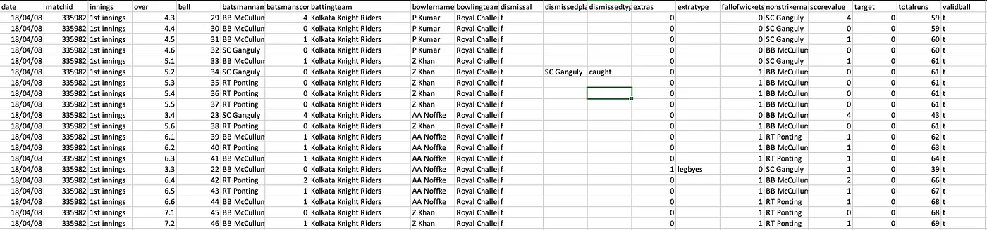
Feature Engineering
features like 50s, 100s, duck outs, Cumulative strike rate, 4 wicket, 5 wicket, Cumulative Economy, Moving average, and Dream 11 scores for the players in the datasets Batsman and bowlers. All these newly engineered features were added to the datasets .
Other Features such as average against opponents,specific bowlers and match venue records were also calculated to include Form and conditions factors, using Yorkpy python library.

Slide 10
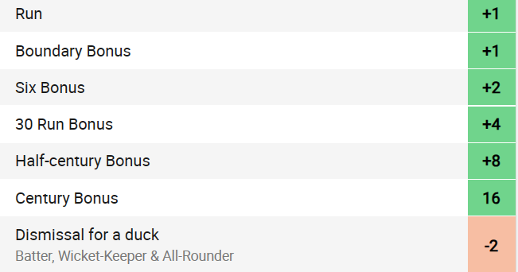
Fantasy League Points Calculator
Dream11 awards points to batsman, bowler, fielders on a point system given below. We used this to convert the batting and bowling statistics to dream 11 points earned for each match.
Reference : https://www.dream11.com/fantasy-cricket/point-system

Slide 11
Training Model Selection
Using classification models for player selection did not seem to be an optimal solution for our problem statement.
Regression models were the best for our problem statement, but we had to support our theory practically.
We tested the prediction accuracy of both classifier and regressor models before proceeding.

Slide 12
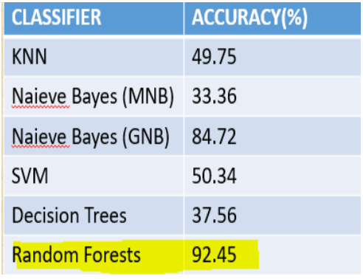
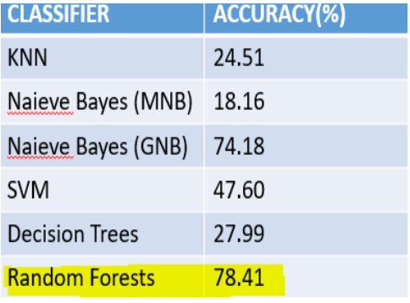
Accuracy of classifier models
These tables show the accuracy of different classifier models for batsmen and bowler data.
Random Forests performs well, but in practical usage, even a difference of 4 points will put us thousands of ranks away, hence classifiers are not preferred.

Slide 13
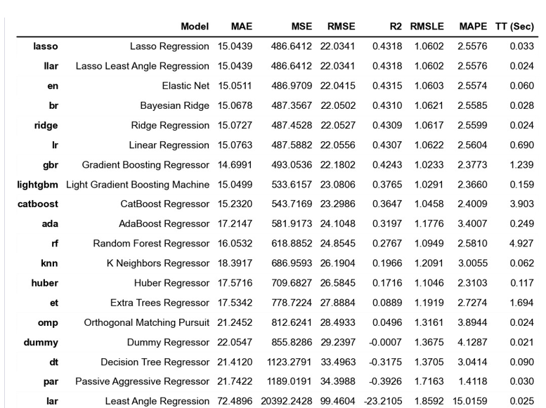
Accuracy of regression models
Upon sampling 10% of the total dataset and applying the regression models in scikit-learn, these results were obtained.
Using Python’s PyCaret library we compared the different regression models
The extra trees regressor models gave the best results with an R2 score of 0.992

Slide 14
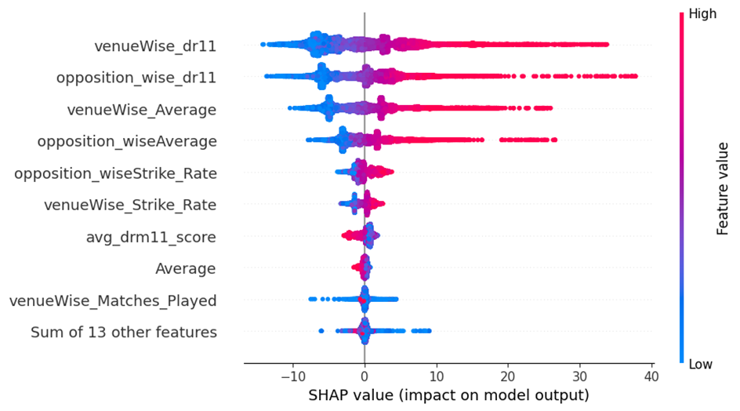
After analysing shap values and feature importance we concluded than a combined effect of strike rate and average in venue data and were greatly impacting the model
Pycaret results showed various accuracy scores of different model and although regularization models like lasso regressing had better r2 value, the gradient boosting algorithms were still unoptimized so we first trained there models

Slide 15
Building the predictor
we trained our models using the match by match data were we had previous engineered values our data frame as we can’t expect the user to know
Hence, the input given by the user will be whether the player is batsman or bowler, the match venue and the teams playing, and all the required features will be extracted from our datasets using this input.
After extraction, we can fit the data into our machine learning model and give the best output.

Slide 16
Extra trees regression
The Extra Trees Regressor, short for Extremely Randomized Trees Regressor, is an ensemble learning method used in machine learning for regression tasks. It's an extension of the Random Forest algorithm and belongs to the class of ensemble methods known as bagging.
Randomized Feature Selection
Random Split Selection
Bagging and Averaging
Reduced Variance

Slide 17
Using Gradient boosting algorithms for training
XGBoost: Short for eXtreme Gradient Boosting, is a highly efficient machine learning algorithm based on gradient boosting. It's widely used for tasks like classification, regression, and ranking due to its speed, accuracy, and versatility. XGBoost incorporates features like regularization to prevent overfitting, handles missing values seamlessly, and provides insights into feature importance. Its ability to handle large datasets, customizable loss functions, and support for parallel computing make it popular in data science competitions. XG-Boost's flexibility, excellent performance, and ease of use have made it a favorite among both beginners and experienced data scientists for building robust predictive models.

Slide 18
Catboost
CatBoost, short for Categorical Boosting, is another powerful machine learning algorithm specifically designed to handle categorical features efficiently. Like XGBoost, CatBoost is based on gradient boosting and is suitable for various tasks such as classification, regression, and ranking. One of CatBoost's standout features is its ability to automatically handle categorical variables, eliminating the need for manual preprocessing. It also incorporates techniques like ordered boosting and oblivious trees, enhancing its predictive accuracy. CatBoost is known for its fast training speed and can handle large datasets, making it a valuable choice for real-world applications. Its user-friendly nature, combined with excellent performance and automatic categorical feature handling, has made it a popular choice among data scientists and machine learning practitioners.

Slide 19
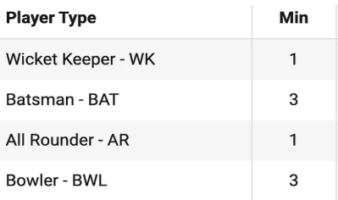
Building a team
The team recommendation algorithm uses a combination of greedy and knapsack algorithms to recommend players within the following constraints.
Must select 11 players.
according to the given constraints

Slide 20
Deployment:
we use python as out backend compiler and Flask framework as our front end which uses jinja2 templating to render our pages
In the app the first page is the team and venue selection where we select the 2 teams and the stadium
Then this data goes to the python code where it extracts derived features from the previously stored dataframes and then use these values for prediction

Slide 21
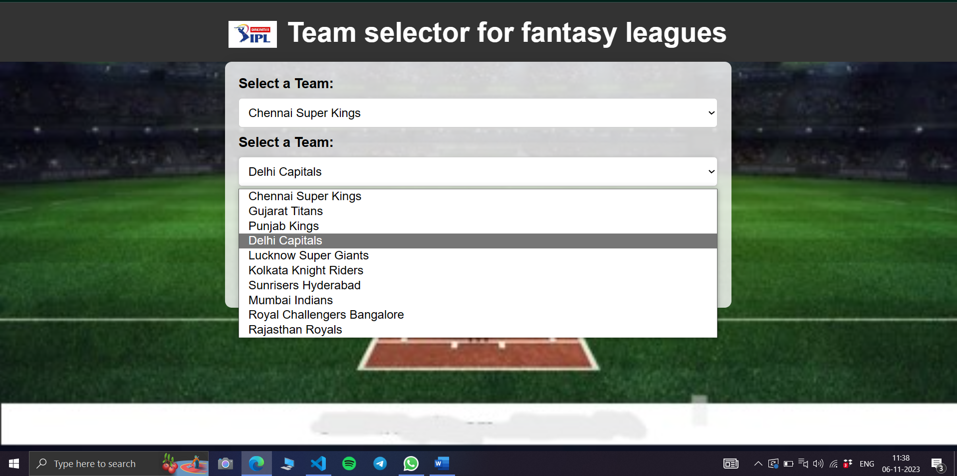

Slide 22
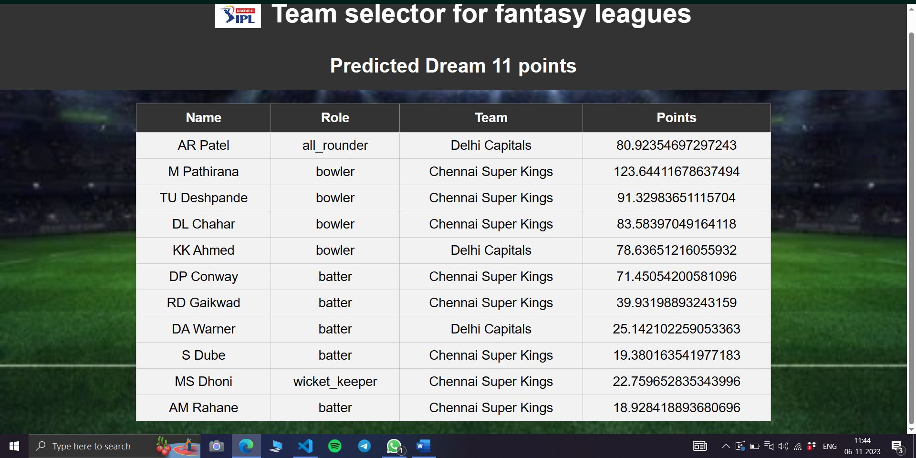

Slide 23

Results & Evaluation
After comparing the accuracy of various models, and measuring the models ability to correctly predict team performance,we collected the results where the gradient boosting algorithms outperformed the previous models used
Although accuracy was improved these were still not enough to win fantasy league games but for these application error was not a good metric to we utilized a rewards based system where we calculated our predicted teams score and then compared it with the top 11 performing players of that match we trained our model upto 2018 and then tested for 2019 and also trained it upto 2022 and then tested on 2023

Slide 24
Future Work
Including weather conditions as they can be very impactful in affecting the course of the game
Using better web scraping systems to collect data in real time and increase our data set
Taking other fantasy league players choice into account to our model
Enhanced player specific analysis taht would incorporate player vs player matchup data

Slide 25
References
Basit, Abdul & Alvi, Muhammad Bux & Alvi, Majdah & Memon, Kashif & Shah, Rehan & Hassan Jaskani, Fawwad. (2020). ICC T20 Cricket World Cup 2020 Winner Prediction Using Machine Learning Techniques. 10.13140/RG.2.2.31021.72163.
Data Science Approach to predict the winning Fantasy Cricket Team Dream 11 Fantasy Sports - Sachin Kumar S, Prithvi H V, C. Nandini
Passi, Kalpdrum & Pandey, Niravkumar. (2018). Predicting Players' Performance in One Day International Cricket Matches Using Machine Learning. 111-126. 10.5121/csit.2018.80310.
Dream11 Team Predictor with Python and Machine Learning | by Madhav Goswami | Analytics Vidhya | Medium

Slide 26


